Slide 1

HI6050 Capstone: Comprehensive Topic Selection and Supplementary Document
Supervisor: Dr. Farshid Keivanian
Session 4: Preparation for Group Research Proposal: Literature Review, Research Question, Tools, Languages & Early Prototyping: Literature Review, Research Question, Tools, Languages, Early Prototyping, Draft & Submit Research Proposal

Slide 2
Session 4’s outline
Preparation for Group Research Proposal: Literature Review, Research Question, Tools, Languages & Early Prototyping: Literature Review, Research Question, Tools, Languages & Early Prototyping
Preparation for Group Research Proposal: Draft & Submit Research Proposal
Group Progress Presentation – Overview of Progress at least 2 min

Slide 3
Group Meeting 1 & Proposal Refinement
Objectives:
Conduct Meeting 1 following agenda template.
Present literature review progress to supervisor.
Identify gaps, refine scope, and get feedback.

Slide 4
Group Meeting 1 & Proposal Refinement
Tasks:
Bring at least 8–10 cited sources in draft form (mix of journals, conferences, industry reports).
Be ready to explain how each source relates to your research question.
Update Meeting Minutes with literature insights and agreed next steps

Slide 5
Group Meeting 1 & Proposal Refinement
Literature Review Expectations This Week:
Start critically comparing sources, not just summarising them.
Identify common methodologies used in your field.
Use subheadings based on themes, not paper-by-paper summaries.

Slide 6
Group Meeting 1 & Proposal Refinement
Do’s:
Allocate action items with clear due dates.
Include supervisor feedback in next week’s work.
Don’ts:
Don’t attend meeting unprepared.
Don’t skip recording minutes.

Slide 7
Group Meeting 1 & Proposal Refinement
Supervisor Check Questions:
What gaps have you identified in existing research?
Are your proposed methods realistic within the trimester?

Slide 8
Preparation for Group Research Proposal: Literature Review, Research Question, Tools, Languages & Early Prototyping
Literature Review & Research Question (Session 1)
Goals:
Start literature review
Define research problem, objectives, scope
Formulate a research question

Slide 9
Preparation for Group Research Proposal: Literature Review, Research Question, Tools, Languages & Early Prototyping
What to Do:
Use the topic selected (e.g., “AI in cybersecurity”) to:
Search academic papers (Google Scholar, ProQuest, IEEE)
Read systematic reviews, meta-analyses, and case studies
Draft:
3–5 objectives
A well-defined scope (what’s in, what’s out)
A single focused research question

Slide 10
Preparation for Group Research Proposal: Literature Review, Research Question, Tools, Languages & Early Prototyping
❌ What to Avoid:
Copy-pasting abstracts into your review
Writing a broad/general research question
Ignoring peer-reviewed sources
Tips:
Use a literature review matrix (tool: Excel or Notion)
Ensure the research question aligns with the topic
Use frameworks (e.g., “PICO”, “SMART”) to refine the question

Slide 11
Preparation for Group Research Proposal: Literature Review, Research Question, Tools, Languages & Early Prototyping
Tools, Languages & Early Prototyping (Session 2)
Goals:
Select the tools/languages/platforms
Choose any datasets (if applicable)
Begin basic prototyping or system design (if technical)

Slide 12
Preparation for Group Research Proposal: Literature Review, Research Question, Tools, Languages & Early Prototyping
What to Do:
Identify:
Programming language (e.g., Python, PHP, Java)
Tools (e.g., Power BI, Tableau, HTML/CSS/JS, Firebase)
Dataset source (e.g., Kaggle, government portals)
Create:
UI wireframes or diagrams (Figma, Canva)
Conceptual database schema (ERD, MySQL Workbench)

Slide 13
Preparation for Group Research Proposal: Literature Review, Research Question, Tools, Languages & Early Prototyping
❌ What to Avoid:
Skipping tool selection thinking it’s “only literature”
Choosing too many technologies
Forgetting to check data licensing and relevance

Slide 14
Preparation for Group Research Proposal: Literature Review, Research Question, Tools, Languages & Early Prototyping
Tips:
Use existing academic project repositories for reference
Tools should match your research question and project scope
For non-coding teams, tools can include data visualization platforms

Slide 15
Preparation for Group Research Proposal: Draft & Submit Research Proposal
Goals:
Finalize all parts of the proposal
Submit Word (.docx) file with cover sheet
What to Include in Proposal:
Title
Abstract
Introduction
Problem Background
Research Question
Objectives
Project Scope
Research Methodology (Literature Review)
Preliminary Literature Summary
Timeline (Gantt chart)
References

Slide 16
Preparation for Group Research Proposal: Draft & Submit Research Proposal
❌ What to Avoid:
Generic or copied abstract
Not citing references properly (Holmes Harvard style)
Missing group members on cover sheet
Tips:
Draft together in Google Docs for live feedback
Submit only from laptop/desktop
Use MS Word format (.docx), no PDFs or Pages

Slide 17
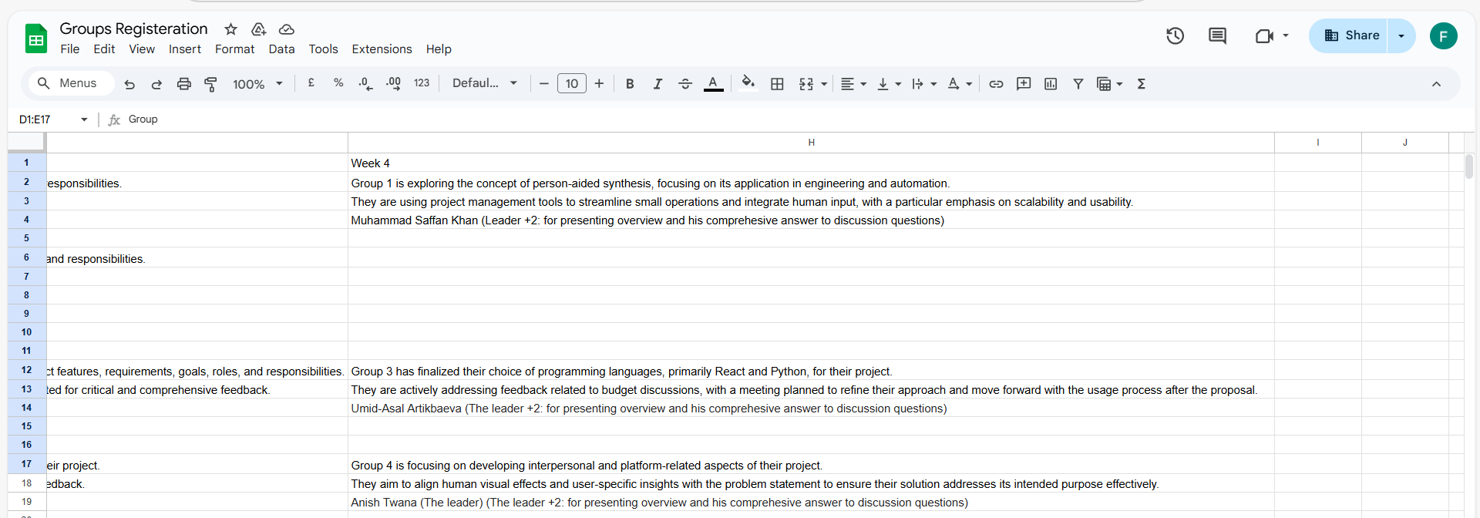
Group Progress Presentation – Overview of Progress at least 2 min

Slide 18
Thank You
Need Help? Send an email or ask during the tutorial session.
Good luck with your capstone journey!
Dr. Farshid Keivanian Supervisor FKeivanian@my.holmes.edu.au

